Slide 1


The regulation of medicines in Australia

Slide 2
Overview
Who’s checking your medicines?
Regulated medicine categories
Registered medicines
Over-the-counter medicine regulation
Generic medicines - bioavailability
Quality, safety and efficacy data
Australian Public Assessment Reports
Assessing and managing risk
Medicines scheduling
Lower risk medicines
Conditions for supply
Access to unauthorised medicines
Advertising medicines
Changing medicine technologies
Other education modules

Slide 3

Who’s checking your medicines?
The organisation that has responsibility for the import, supply, or export of medicines in Australia is the Therapeutic Goods Administration
The Therapeutic Goods Act 1989 requires that products must be entered on the Australian Register of Therapeutic Goods (ARTG)
To make this happen a sponsor (usually the company that will supply or manufacture the product) must submit an application and pay fees to the TGA
This presentation will take you through some of the critical things the TGA does

Slide 4
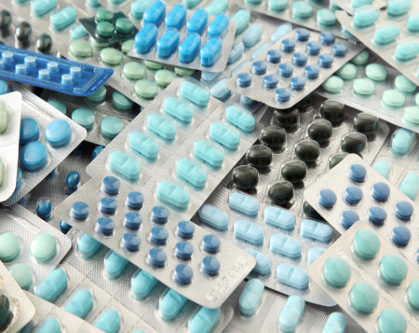

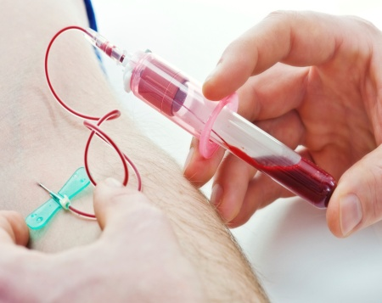
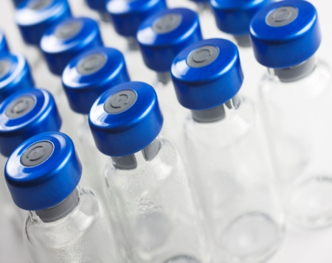
Regulated medicines include:
Prescription medicines (including original and generic brands)
Over-the-counter medicines (including pharmacy, pharmacist only and unscheduled medicines)
Complementary medicines
Vaccines
Blood, blood components and plasma derivatives
All these products are regulated by the TGA

Slide 5
Two broad categories of medicines
Approach is based on risk and, in the simplest terms, has two tiers:
Registered medicines:
higher risk medicines that are registered on the ARTG
evaluated for quality, safety and efficacy
Product Information is approved by the TGA
Listed medicines:
lower risk medicines that are listed on the ARTG
contain pre-approved, low risk ingredients
can only make limited claims and cannot imply that they will be useful in the treatment or prevention of serious illnesses

Slide 6


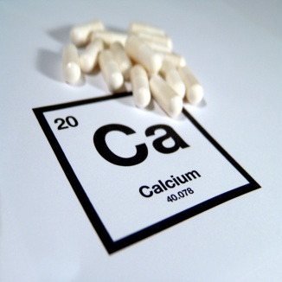
Registered medicines
Prescription
(any medicine that requires a prescription from a practitioner)
Higher level of risk
All prescription medicines are registered
Most over-the-counter medicines are registered
Some complementary medicines are registered
Registered medicines have an 'AUST R' number on the label and/or packaging
Over-the-counter
(lubricating eye drops from behind the counter without a prescription)
Complementary
(high dose calcium tablets from behind the counter without a prescription)

Slide 7
Registering a new medicine
There is a large amount of information to consider
It takes approximately 11 months to evaluate one new higher risk prescription medicine
Evaluation is undertaken by scientists and clinicians who look at data on:
Quality*
Safety and efficacy*
3. Evaluation
2. Screening
4. Decision
Process of checking and communicating with applicant
1. Preparation and lodgement
5. Finalisation
*More information about what this means is provided later in the presentation

Slide 8
Over-the-counter medicine regulation
Applications can be submitted in five application categories, each of which relates to different evaluation processes that corresponds to the level of risk.
Low risk category
Clones (identical product to existing approved)
Name variations
Flavour, fragrance or colour variations
New patient population
New indication
New active ingredient
High risk category
Preparation and Lodgement Screening Evaluation Decision Finalisation
8

Slide 9

Bioavailability studies – data from applicant Generic prescription medicines must be bioequivalent
Bioequivalence refers to whether the generic medicine releases the active ingredient into the bloodstream at the same rate and to the same extent as the original medicine
Bioequivalence is demonstrated by conducting a bioavailability study in which volunteers (usually healthy) are given the original Australian medicine and, on a separate day, the generic medicine
Blood samples are taken at different times and the rate and extent of absorption of the active ingredient into the blood is compared for the generic and original medicines

Slide 10



Decisions are based on evidence Quality data - supplied by the applicant
Evaluated by chemists, biochemists, microbiologists and others working for the TGA
the composition of the substance and the product
batch consistency
stability data
sterility data (if applicable)
the impurity content

Slide 11
Quality considerations Batches of medicine should be ‘the same’
European Union guidelines – some with TGA annotations – provide guidance on how to judge the quality of medicines
The official standards in Australia are:
British Pharmacopoeia
European Pharmacopoeia
United States Pharmacopoeia-National Formulary
Some (not all) EU guidelines are adopted by the TGA and may also refer to one or more of the standards above
Drug substance: each batch should contain acceptable impurity levels
Drug product: each tablet should contain ‘the same’ amount of active ingredient
Stability studies must be conducted under conditions that represent tropical regions, because Australia contains significant populations in the tropics

Slide 12
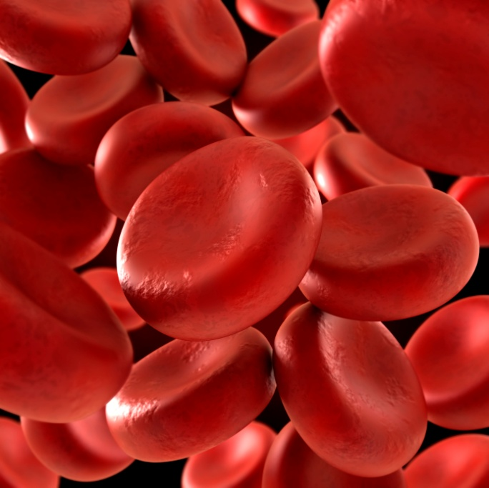
Example of a container affecting quality
Epoetin alfa (erythropoietin) contained human serum albumin for stability
Proteins of human origin create a risk of human diseases, so the albumin was replaced with a detergent, polysorbate, with TGA approval
Within months of the formulation change, there were reports of pure red cell aplasia* (PRCA; erythroblastopenia) in Australia (TGA), the EU, Canada and Singapore
Determined that PRCA was associated with the new formulation, prefilled syringes (not vials) and subcutaneous injection, but was not batch specific
*PRCA is characterised by severe anaemia and the absence of erythroblasts in the bone marrow.
Sponsor changed to using teflon-coated plungers in syringes (with TGA approval) and PRCA dropped to previous low rate within the year.

Slide 13
Decisions are based on evidence Safety and efficacy data - supplied by the applicant
Nonclinical data
Evaluated by toxicologists and pharmaceutical chemists
Clinical data
Usually evaluated by a medical doctor
Pharmacology data – laboratory data investigating efficacy
Pharmacokinetic data
Toxicology data – laboratory data investigating safety
Mostly results of clinical trials conducted by pharmaceutical companies and/or hospitals or research organisations, using volunteers
TGA

Slide 14
Safety information helps determine risk Taking medicines involves risk
European Union guidelines describe how studies should be designed to obtain statistically valid safety information
Considers how valid the results of nonclinical studies in animals and increasing in vitro (e.g genomic assays) are by investigating:
genotoxicity
organ toxicity
carcinogenicity
reproductive toxicity
Any safety concerns from clinical trials?

Slide 15
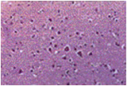
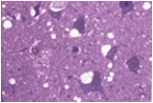
Minimising infectious diseases Bovine spongiform encephalitis – mad cow disease transmissible to humans
Normal brain section
The TGA took regulatory action when this infectious disease first emerged
Transmissible spongiform encephalitis (TSE) is a degenerative neurological disorder known in humans as variant Creutzfeldt-Jakob disease (vCJD)
Affected brain section
The brain tissue develops holes and takes on a sponge like texture. Clinical features include psychiatric symptoms and neurological signs.
Australian cattle were unaffected, so Australia was in a position to take tough regulatory action in relation to medicines containing ingredients that came from cattle in order to protect human health

Slide 16
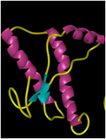
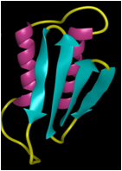
First known protein adventitious agent
Scientific dogma: all infectious diseases must involve nucleic acid (RNA or DNA) - multiplication occurs by replication
PrP^{c} normal
PrP^{sc} diseased
For TSE no nucleic acid is involved: prions are misfolded PrP protein that can induce host PrP protein to undergo conformational change
PrP^{c} (α-helical conformation) changes to PrP^{sc} (misfolded protein – β sheet structure, resistant to proteinase digestion)
Normal sterilisation techniques including gamma and UV radiation have no effect on the protein
Regulatory control focused on restricting the source of bovine material in medicines to countries known to be free from BSE

Slide 17
Efficacy information helps determine benefit There must be evidence of clinical benefit
European Union guidelines provide guidance on how to judge the efficacy of medicines
Could it work? – nonclinical studies and animal studies
in vitro, such as receptor-binding
in vivo
Does it work? – clinical trials
“end points” to judge clinical benefits need to be agreed
needs to be both clinically and statistically significant
placebo effect needs to be accounted for
Mechanism of action
sometimes informs safety information
sometimes informs drug interaction information

Slide 18
History of paliperidone Using medicines in a new patient population
An application was made to the TGA to allow the use of the medicine paliperidone in adolescents aged 12-17 years old with schizophrenia—this use was authorised in approximately 10 countries, including the USA
The TGA was concerned about the design of the main clinical trial to support use of paliperidone in Australian adolescents and asked the Advisory Committee on Prescription Medicines for advice
Paliperidone and the related medicine risperidone are both used to treat schizophrenia. The Australian Product Information states that paliperidone ‘should not be used in patients younger than 18 years’ and risperidone ‘is lacking evidence in children with schizophrenia aged less than 15 years’
1
2
3

Slide 19
Outcome for paliperidone Using medicines in a new patient population
The Advisory Committee on Prescription Medicines considered the study inadequate to support the proposed use in adolescents. The committee expressed significant concern about the design, duration, patient selection, screening and analysis of the main clinical study
After receiving the TGA evaluation reports, overview and advice from the Advisory Committee on Prescription Medicines, the application was withdrawn and the Product Information for paliperidone still states that it should not be used in patients younger than 18 years
The TGA was also advised that different adverse events are associated with each of the two medicines. Risks include abnormal movement disorders and metabolic syndrome, causing weight gain and diabetes
4
5
6
See the AusPAR for more information.

Slide 20
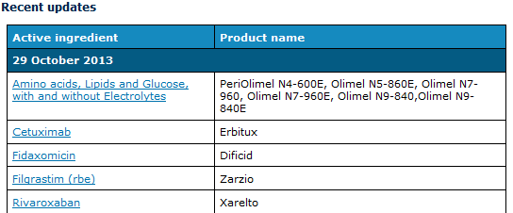
Find out more by reading an AusPAR!
An Australian Public Assessment Report provides information about the evaluation of a prescription medicine and the considerations that led the TGA to approve or not approve an application to register a prescription medicine
Includes summaries of pharmacodynamics, pharmacokinetics, efficacy and safety, as well as the first and second round benefit-risk assessments

Slide 21

Assessing and managing risk What do we do?
Consider risks – what are they?
Balance benefits with risks
Consider whether a medicine should be used in the proposed population for the proposed indication
Use Product Information document as a risk management tool
Consider other risk management tools

Slide 22
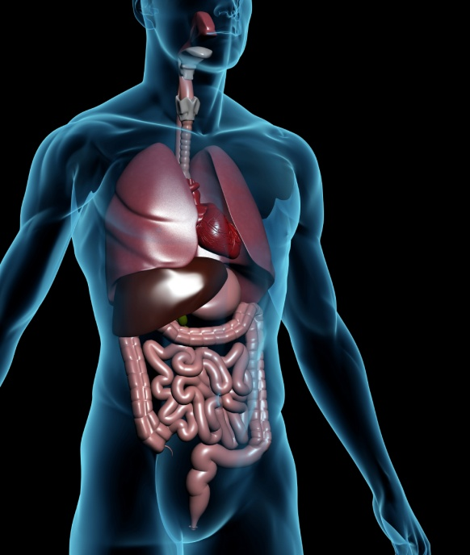
Product Information document A risk management tool
The document is approved by the TGA
The product is only authorised for specified patient population for specified indications
All other use is ‘off-label’ and the benefit-risk profile has not been considered by the TGA
The precautions section gives details of some of the risks involved

Slide 23
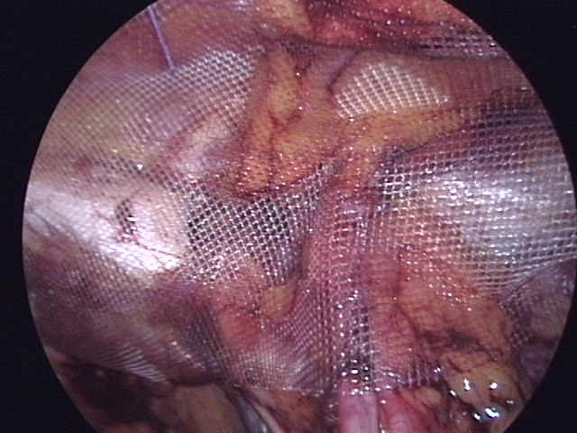
Example of PI as a risk management tool
A fibrin sealant was already authorised for a number of indications
The application was to extend the indications to include fixing meshes used in hernia repair operations
This submission consisted mostly of studies published in the literature
When the fibrin sealant was used in nonclinical studies to fix a mesh to the peritoneum, the mesh often did not stay in place
This information is now in the precautions section of the Product Information
Mesh graft
Picture source: Anpol42

Slide 24
Planning for safety
A risk management plan states how safety concerns will be identified and mitigated. It is a required component in the premarket authorisation process and is also updated to cover the entire life of the product
It consists of:
an overview of the safety profile
a pharmacovigilance plan
a risk minimisation plan

Slide 25
How can we control use?
A risk management plan might require the sponsor to:
Report on adverse events
Develop educational program
Limit supply to authorised prescribers
Keep a registry of patients
Automatically recruit on registry when product is prescribed

Slide 26
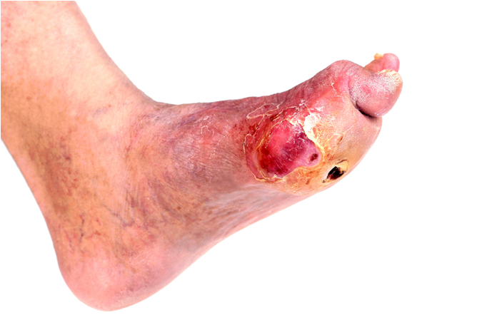
First medicine in class – dapagliflozin
Selective and reversible inhibitor of the sodium-glucose co-transporter 2 (SGLT2), the major transporter for glucose reabsorption in the kidney
Used for the treatment of type 2 diabetes as an adjunct to diet and exercise
Long term benefits are likely to follow from reducing blood glucose levels in type 2 diabetes
Safety concerns: renal impairment, urinary tract infections, genital infections, dehydration, osteoporosis
Diabetic foot infection
Nonclinical studies did not indicate any carcinogenic concerns. Bladder and breast cancer in clinical trials was considered by the TGA as unlikely to be treatment-related, but this could not be ruled out
26

Slide 27
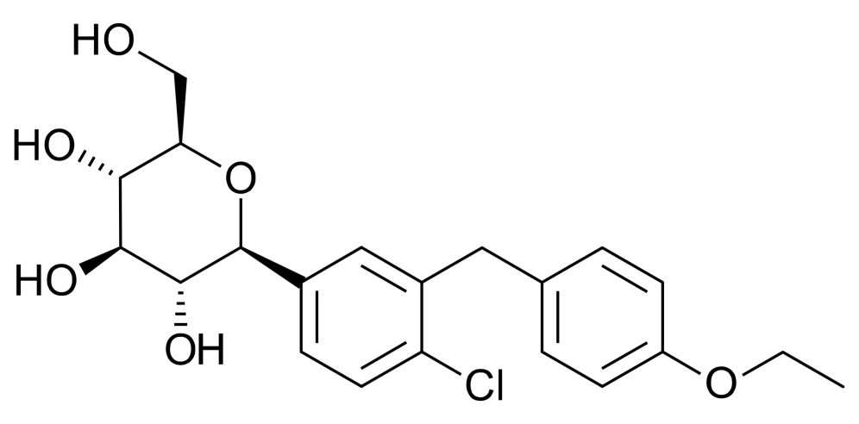
Dapagliflozin – conditions of registration
New class means limited relevant clinical knowledge in real world – the TGA did not authorise first line monotherapy because of safety record of metformin
Authorised only for type 2 diabetes. Not authorised in the moderately renally impaired (defined as: eGFR <60 mL/min)
A specific condition of registration was that a postmarket study strategy be agreed by the TGA prior to marketing
The sponsor was required to conduct an education program for health professionals to minimise the possibility of dapagliflozin being used for weight loss
An Australian-specific Annex to the risk management plan was required, to outline pharmacovigilance measures if there were delays in authorisation by the EU and/or US

Slide 28
Medicines scheduling–the Poisons Standard
Potentially dangerous drugs and chemicals are restricted to enable their safe and effective use
Scheduling is the legal process used to achieve this
Scheduling decisions are made by a senior TGA medical officer taking into account the advice of the Advisory Committee on Medicines Scheduling
The higher the number of the schedules, the more access is restricted
Scheduling is in legal terms a State matter, but all States now adhere closely, or entirely, to the Poisons Standard, which is administered by the Department of Health
Scheduling decisions are published on the TGA website
Remember: only registered medicines are scheduled
28

Slide 29
Examples of scheduled medicines
Schedule classification | Type of medicine | Example
Schedule 2 | pharmacy only medicine | large packet sizes of paracetamol
Schedule 3 | pharmacist only medicine | topical thrush treatments
Schedule 4 | prescription only medicine | blood pressure medications
Schedule 8 | controlled drug – S8 has additional restrictions on the storage and supply of medicines | strong upload painkillers

Slide 30
Rescheduling alprazolam
Increased morbidity and mortality in overdose with possible increased toxicity
Alprazolam belongs to a group of medicines called benzodiazepines which are used to treat anxiety and panic disorders.
Submissions to the TGA suggested that Alprazolam should be rescheduled from Schedule 4 to Schedule 8 due to:
Rapid increase in use and evidence of widespread misuse
Concerns that the current pack size is inappropriate for indications
Evidence of misuse with opioids
As of 1 February 2014, alprazolam will be a Schedule 8 controlled substance. More information: <http://www.tga.gov.au/industry/scheduling-decisions-final.htm> June 2013

Slide 31

Listed medicines
Lower level of risk
Some over-the-counter medicines are listed
Most complementary medicines are listed
Listed medicines have an 'AUST L' number on the label
Must NOT contain substances that are scheduled in the Poisons Standard
Must contain pre-approved ingredients

Slide 32





Regulating listed medicines premarket
Only pre-approved low risk ingredients may be used in listed medicines
Listed medicines, including most complementary medicines, receive a lesser degree of checking than higher risk products
Regulation centres on the safety of the ingredients and the consistency of the manufacturing process; sponsors must hold evidence to support the claims
Independent expert advice may be sought on new ingredients proposed for use in listed medicines
Listing on the ARTG is the final stage of the process and usually occurs once the sponsor has paid their fees and signed a statutory declaration

Slide 33
Conditions for supplying low risk medicines
Echinacea
Does not claim or imply it will be useful in the treatment or prevention of serious illnesses
Contains pre-approved low-risk ingredients
Fish oil tablets
Vitamin C
Iron tablets
The TGA inspects and licenses manufacturing sites in Australia and assesses sites overseas. This allows us to enforce standards in relation to sterility and quality of the ingredients used and the process followed.

Slide 34



Patients sometimes need special access
We help health professionals gain access to products that their patients need, but which have not been approved for use in Australia.
Clinical Trial Exemption (CTX) and Clinical Trial Notification (CTN) schemes
Special Access Scheme (SAS)
Authorised Prescribers
Access unapproved medicines through participation in a clinical trial
Import and/or supply an unapproved therapeutic good for a single patient on a case-by-case basis
Authorised prescribers can prescribe a specified therapeutic good (more than once) to a patient with a particular medical condition

Slide 35

Advertising medicines It’s important
The labelling, packaging and description of what the medicine should be used for are all regulated by the TGA
Advertising of prescription medicines to consumers is illegal in Australia

Slide 36
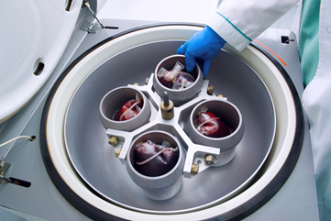
Changing medicine technologies
1960s
1970s
1980s
Medicines were relatively small molecules
Manufactured from chemicals, such as aspirin, or were a product of fermentation, such as penicillin and cortisone
1990s
Human plasma started to be used to provide products such as Factor VIII for haemophilia
Human proteins produced in bacteria using recombinant DNA technology
Human insulin produced - avoided problems of allergic reactions to animal insulin
Human proteins available: insulin, growth hormone and interferon
More than a hundred protein medicines were produced using recombinant DNA technology
Virus proteins could be produced without the actual virus and used as vaccines

Slide 37
Protein/peptide medicines registered in 2012
Medicine | Disease state
Belimumab (Benlysta) | Systemic lupus erythematosus
Peginterferon Alfa 2a (Pagasys) | Hepatitis C
C 1 esterase inhibitor (Cinryze) | Hereditary angioedema attacks
Velaglucerase alfa (Vpirv) | Glucocerebrosidase deficiency (Gaucher disease)
Afibercept (Eylea) | Age related macular degeneration
Human fibrinogen and thrombin (Tachosil) | Cardiovascular surgery
Adalimimab (new presentation - Humira) | Arthritis, Crohn’s Disease
Insulin aspart (multidose – Novorapid Fextouch) | Diabetes
Eptacog alfa (NovoSeven RT) | rFactor VIIa – uncontrolled bleeding

Slide 38


Regulation after product is on the market
We have created a separate educational module on postmarket regulation, which details what we do once products are in the supply chain. This is an integral part of the regulatory system.
The module covers:
tools used in postmarket monitoring
signal investigation
recall actions
There are five other modules in this suite of educational material. These can be accessed by the links on the next slide.
38

Slide 39
Other education modules include:
Introduction to the TGA
Biologicals
Medical devices
Postmarket monitoring
Good Manufacturing Practice

