Slide 1


Regulating the manufacture of therapeutic goods

Slide 2
Overview
Checking the quality of therapeutic goods
Higher, medium and lower risk products
The basis of Good Manufacturing Practice
Looking at the actual product
The manufacturer
Inspections
Australian manufacturers
international manufacturers
The future of manufacturing
Multi-step manufacturing processes
International harmonisation
Other education modules

Slide 3


Checking the quality of therapeutic goods
The TGA monitors and assesses manufacturers
to ensure that therapeutic goods supplied in Australia are manufactured to a high standard
The emphasis and depth of manufacturer inspections, as well as the frequency of inspections, are guided by the inherent risks of the product and the method of manufacture.
We also take into account the compliance and inspection history of the manufacturer

Slide 4

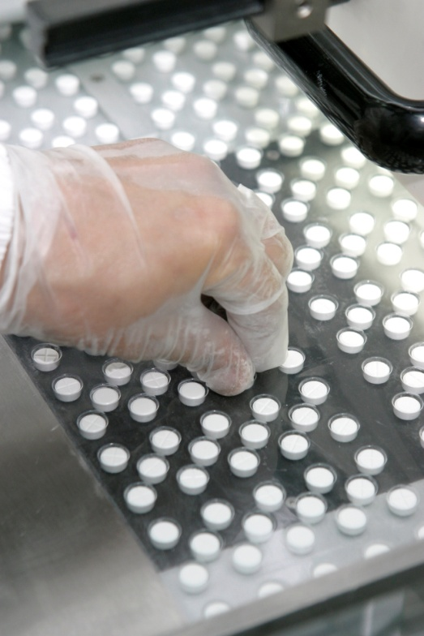
How do we do this
Australian and overseas manufacturers are assessed prior to supply of goods and are then regularly reviewed
On-site inspections of manufacturers and compliance verifications (paper-based assessments)
Inspections against the relevant Code of Good Manufacturing Practice (GMP) or Standard (for devices) which describes the range of conditions required for the safe, sterile production of goods
Quality manufacturing

Slide 5
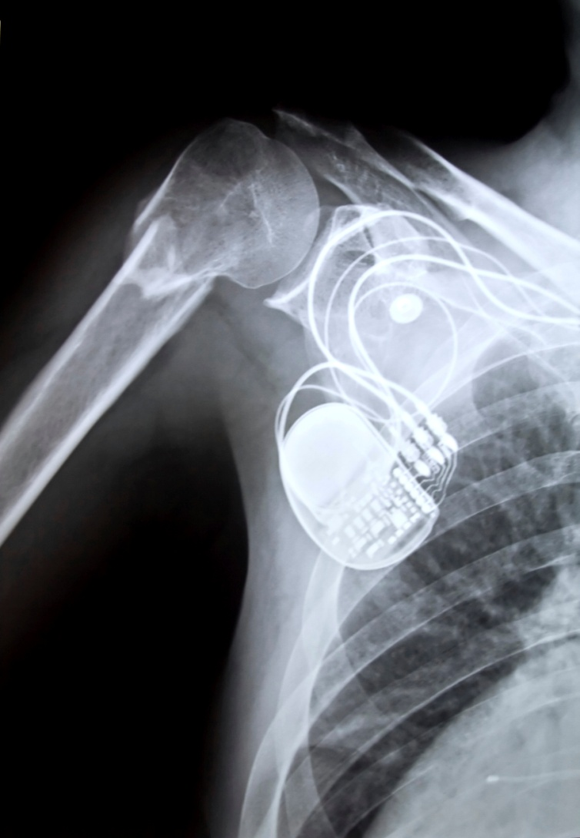
Higher risk products
Sterile medicines, including active pharmaceutical ingredients
Single step sterilisers
Non-sterile medicines containing antibiotics,
steroids or antineoplastics
Primary collection, processing and storage sites for blood, including human haematopoietic stem cells
Tissue banks with complex processing
Cellular therapies
Medical devices - Class III and Active Implantable
Medical Devices (AIMD)
Pacemakers are regulated as AIMDs
5

Slide 6
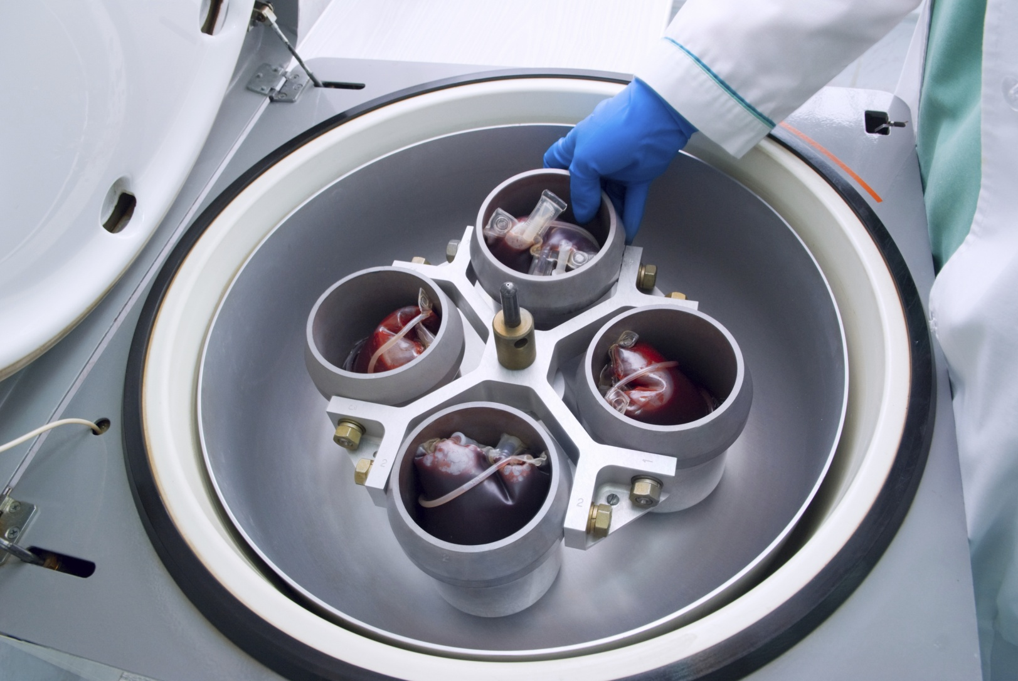
Medium risk products
Non-sterile medicines, including herbal products
Secondary blood collection and separation sites (including sites collecting plasma only or platelets)
Tissue banks with low manipulation
Other medical devices
Plasmapheresis

Slide 7

Lower risk products
Minerals, vitamins, fish oils and other supplements
Sunscreens
Medicinal gases
Other blood collection sites including mobile units
Homeopathic medicines

Slide 8

The basis of Good Manufacturing Practice
A basic tenet of GMP is that:
Simply testing a product after manufacture is not sufficient to ensure product quality
Quality must be built into each batch
of a product during all stages of the manufacturing process

Slide 9
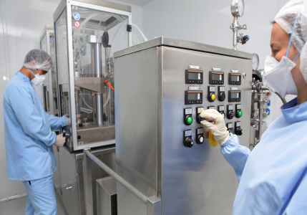
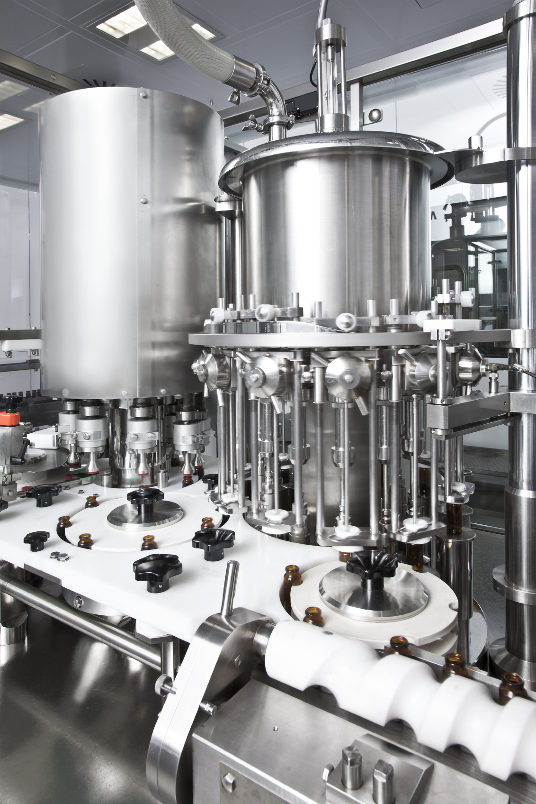
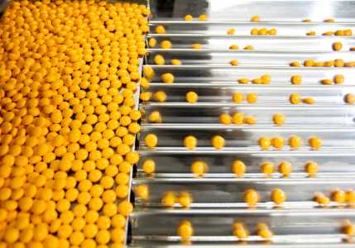
Looking at the actual product
GMP requirements cover:
How products are manufactured, packaged,
labelled and stored
How therapeutic goods are tested to ensure that
products are of a suitable quality, including the final evaluation and approval for use by the manufacturer of each batch made

Slide 10
The manufacturer must:
  Have a quality management system in place under which manufacturing activities are controlled
  Include in the system personnel involved in the control of therapeutic goods manufacturing and how they are trained
  Provide information on how premises used in the manufacture of goods are designed, operated, maintained and controlled
  Control manufacturing activities through the use of written procedures and instructions
  Record manufacturing events through comprehensive record keeping practices

Slide 11
Inspections include verification that:
All manufacturing processes are clearly defined and regularly reviewed
Records of all manufacturing activities are kept
Critical manufacturing processes and changes are validated
All starting materials and finished products are sampled, tested and approved for use using appropriate methods
Written instructions for all tasks are developed and available
Batches are certified as fit-for-purpose prior to distribution

Slide 12
Inspections ensure quality of therapeutic goods
Planned and unplanned inspections are undertaken to assess compliance with GMP standards, both domestically and overseas
    The emphasis, depth and frequency of inspections for a particular manufacturer are guided by the inherent risks of the product and the method of manufacture as well as:
      manufacturer size
      complexity of their products
      compliance history

Slide 13
Inspecting Australian manufacturers
In Australia, the TGA manages annually:
~400 licences for manufacturing, supply and distribution sites
~450 sites
~250 inspections of sites
*statistics per annum, current as of July 2013

Slide 14
Manufacturers who receive a basic rating
Where ‘basic’ is considered just acceptable, the TGA applies a specific strategy to each manufacturer to enforce improvement by a combination of the following:
      follow up and close out inspections where required
      a letter to outline any concerns where required
      inspections every 12 months

Slide 15
Which countries supply to Australia?
Therapeutic goods are manufactured and supplied in a global market
This includes both finished goods and ingredients
Countries who manufacture or supply to Australia include:
Sites:
*current as of July 2013

Slide 16
Inspecting international manufacturers
TGA inspection and certification of overseas sites
~2,000 manufacturers > 2,500 sites
~3,500 clearances
150-200 on-site inspections
Increasing number of compliance verifications (using inspection reports from other agencies)
*statistics are per annum, current as of July 2013

Slide 17

The future of manufacturing
Manufacturing is being expanded to developing countries
Faster access to products for Australians
Multi-step manufacture of products is common
Complex supply chains which may span many different countries
Challenges with different languages

Slide 18
Multi-step manufacturing process
Example of an over-the-counter medicine
The manufacturing process for medicines may occur in stages. In the following real world example, an over-the-counter medicine may be handled by four different companies across three countries before it reaches the market.
Company B
United Kingdom
Company D
Australia
  Manufacture active ingredient
  Packaging and labelling
  Quality
  control
  Secondary labelling
  Release for supply
Company A
USA
Company C
Australia

Slide 19
Multi-step manufacturing process
Example of a prescription medicine
Company A – in Pennsylvania, USA – may complete every stage of the manufacturing process OR it may only manufacture the active ingredient, with the following stages being completed in one of a number of alternative sites
Company A
Virginia, USA
Company B
the Netherlands
Company B
Australia
Company C
Australia
  Manufacture of dosage form
  Secondary packaging
  Release for supply
  Secondary packaging
  Release for supply
  Release for supply

Slide 20

International harmonisation
International harmonisation of standards and inspections allows for a shared workload with regulators in other countries
It may include:
      joint inspections with overseas partners
      shared inspection scheduling
      sharing of information, reports and manufacturer information
      mutual recognition of codes of GMP and standards

Slide 21
Other education modules include:
Introduction to the TGA
Medicines
Biologicals
Medical devices
Postmarket monitoring

