Slide 1
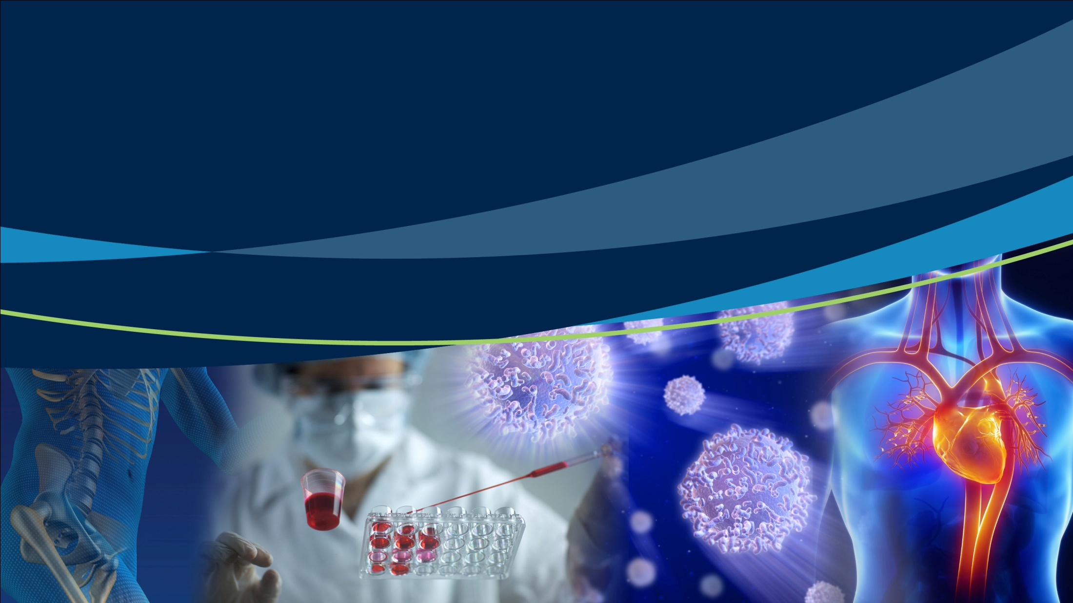

The regulation of biologicals in Australia

Slide 2

Overview
What are biologicals?
The Australian biologicals framework
Products regulated as medicines
New and experimental products
Clinical trials
Risk management
Classes of biologicals
Current uses of biologicals
The registration process
Exceptional release provisions
Postmarket monitoring
Other education modules

Slide 3
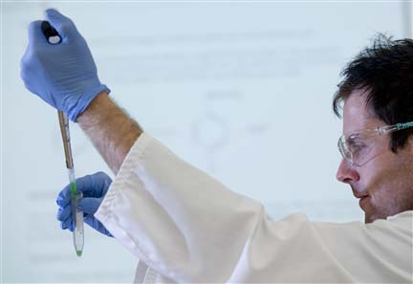
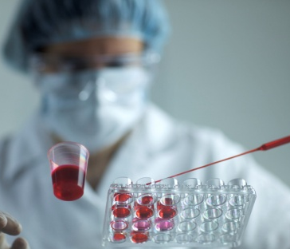
What are biologicals?
In Australia, ‘biologicals’ is the name for cell and tissue therapy products:
products in tissue banks
stem cell therapy products
excludes in vitro fertilisation products
excludes blood.
Other countries use different names for these products.
On 31 May 2011 a new regulatory framework was introduced to provide a legislative basis for the regulation of these products.
It applies different levels of regulation to products based on the risks associated with their use, and was designed to accommodate emerging technologies.

Slide 4
The Australian biologicals framework
Not regulated by the TGA*
Regulated, but not as biologicals^
Regulated as biologicals
Fresh viable organs
Assisted reproductive technologies (in vitro fertilisation)
Animal tissue products (xenotransplantation)
Tissue-based products (skin, bone, ocular, cardiovascular)
Fresh haematopoietic progenitor cells (bone marrow transplants)
Biological prescription medicines (vaccines, plasma derivatives)
Cell-based products (T cell therapies, human stem cells)
Cells and tissues made by a medical practitioner for a single patient under the care of that medical practitioner
Labile blood and blood components
Haematopoietic progenitor cells (non-fresh transplants)
Combined cell and tissue products (collagen matrices for localised cell delivery)
*It is not practical to regulate these products. There are appropriate checks in place because of professional practice.
^These are regulated as either medicines or medical devices
4

Slide 5
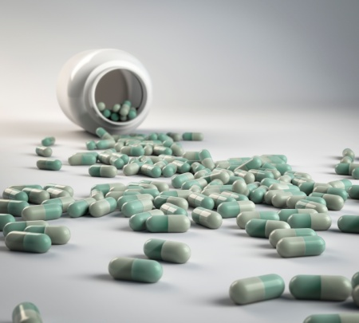
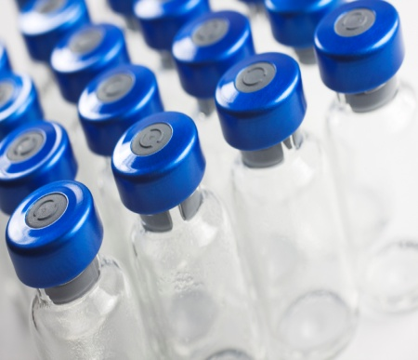
These products are regulated as medicines
Antibiotics
Heparin
Antivenoms
Immunoglobulins
Monoclonal antibodies
Hormones such as insulin and growth hormone
Blood products and clotting factors
Vaccines
Enzymes such as pancreatin

Slide 6
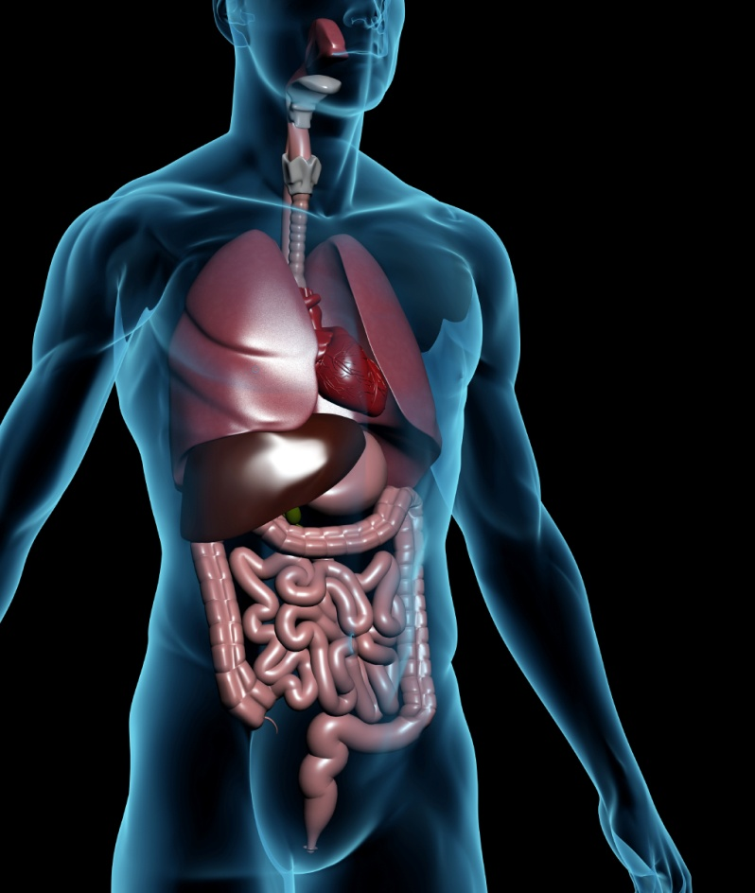
New and experimental products
Stem cell therapies are largely new and experimental
These offer great hope to people with serious incurable diseases:
Parkinson’s disease and other neurodegenerative diseases
spinal cord injury
heart disease, stroke and arthritis
Patients are sometimes desperate for these therapies to become a reality, however there are risks involved; the therapy is generally delivered via surgery, and the patients may require immunosuppressants for the rest of their life
But a lot of work is still needed to turn the research into safe and effective treatments

Slide 7
Clinical trials
One or more ethics committee approves every Australian clinical trial
The TGA is notified of all clinical trials (the Clinical Trials Notification scheme – CTN)
Some clinical trials are in the Clinical Trials eXemption scheme (CTX)
the details of these trials are examined, and commented on, by TGA staff
the ethics committee may then give approval to proceed
Clinical trials with biologicals in Australia offer access to new (but unproven) therapies.
Each trial has a research purpose, and patients need to provide informed consent
It is expected that most clinical trials for higher risk biologicals will take quite a few years
7

Slide 8
Higher and possibly unknown risks
Global clinical and regulatory experience with biologicals is more limited than with medicines
There is an increased risk of infectious disease transmission. It is difficult to obtain complete history for deceased donors
Because of limited clinical experience with biologicals unforseen side effects are more common
Biologicals usually cannot be removed once they’re in the recipient’s body, but there is new work where researchers are introducing ‘suicide genes’ which can be turned on if something goes wrong and these genes kill the introduced cells
For more information: International Society for Stem Cell Research (ISSCR) <www.isscr.org>
8

Slide 9
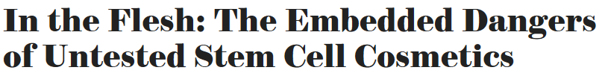
Transplanted cells became bone
A report in the December 2012 edition of Scientific American gave details of a patient having a facelift that used her own adult stem cells.
During the procedure, the cosmetic surgeons combined mesenchymal stem cells with a dermal filler containing calcium hydroxylapatite, a mineral with which can encourage mesenchymal stem cells to turn into bone—a fact that escaped the patient’s clinicians.
The transplanted cells turned into bone in the tissue surrounding the eye.
The patient experienced pain and loss of mobility, and had to undergo surgery to remove the bone fragments.

Slide 10
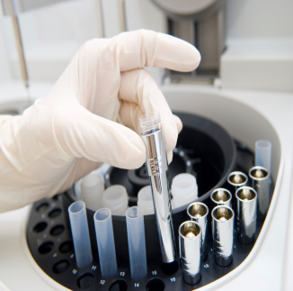
Regulation takes into account risk
Centrifugation is an example of minimal manipulation of a biological. Genetic modification is an example of high manipulation
A risk classification system is used for biologicals to be included on the Australian Register of Therapeutic Goods (ARTG)
The risk class depends on:
how far removed they are from their naturally occurring state (how much they have been manipulated during the extraction and production process)
how closely the intended use matches the natural biological function
The main risk with using biologicals is the spread of infection
10

Slide 11
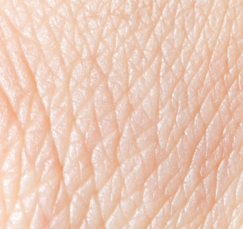
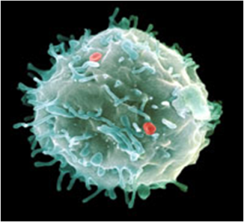
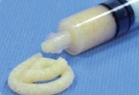
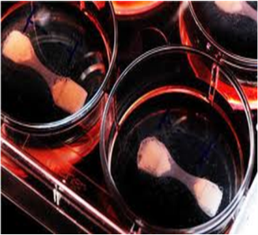
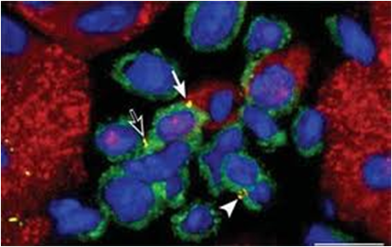
Biologicals are grouped into classes Examples:
Acellular skin for wound covering
Mesenchymal stem cell for treatment of graft-versus-host disease
Demineralised bone mixed with carrier
Dermal fibroblasts transformed for skeletal muscle repair in primary myopathy
Genetically-modified T cells used to treat specific virus infections
Class 2
Class 3
Class 3
Class 4
Class 4

Slide 12
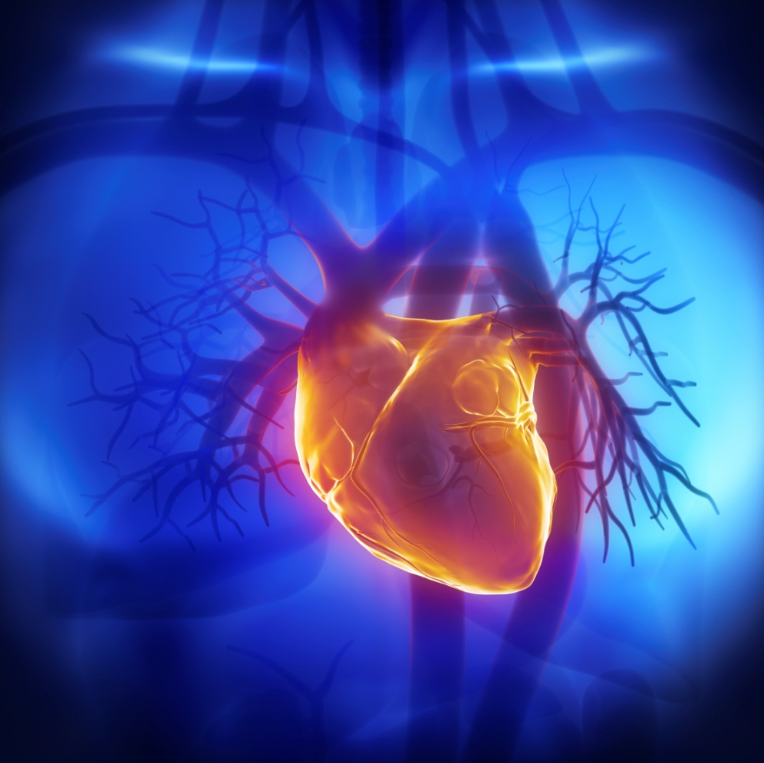
Current uses of biologicals
Corneal transplants can restore sight in patients whose eyes have been affected by disease, injury or infection
Skin grafts are used for patients with burns
Biological heart valves
Bone transplants are often donated by hip replacement patients
Tendon transplants are used to help restore mobility to arms, elbows, hands etc
Turning human stem cells into heart cells, pancreatic beta cells, intestinal cells, liver cells, and nerve cells

Slide 13
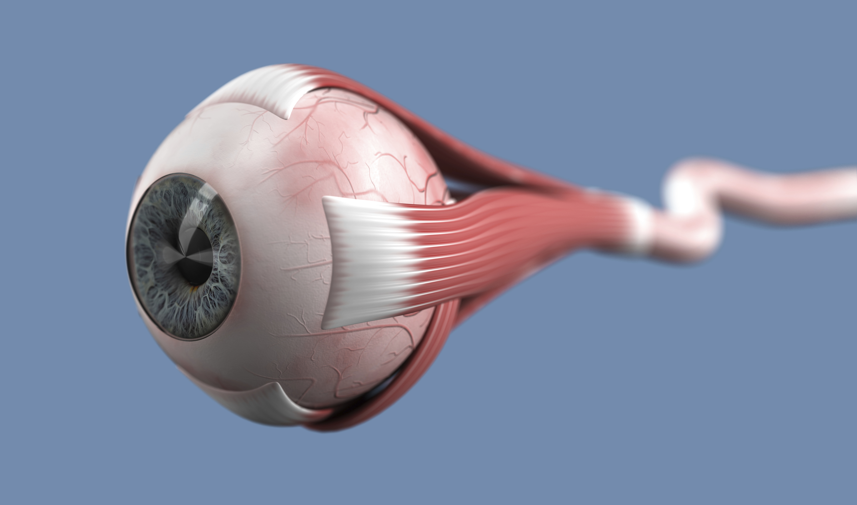
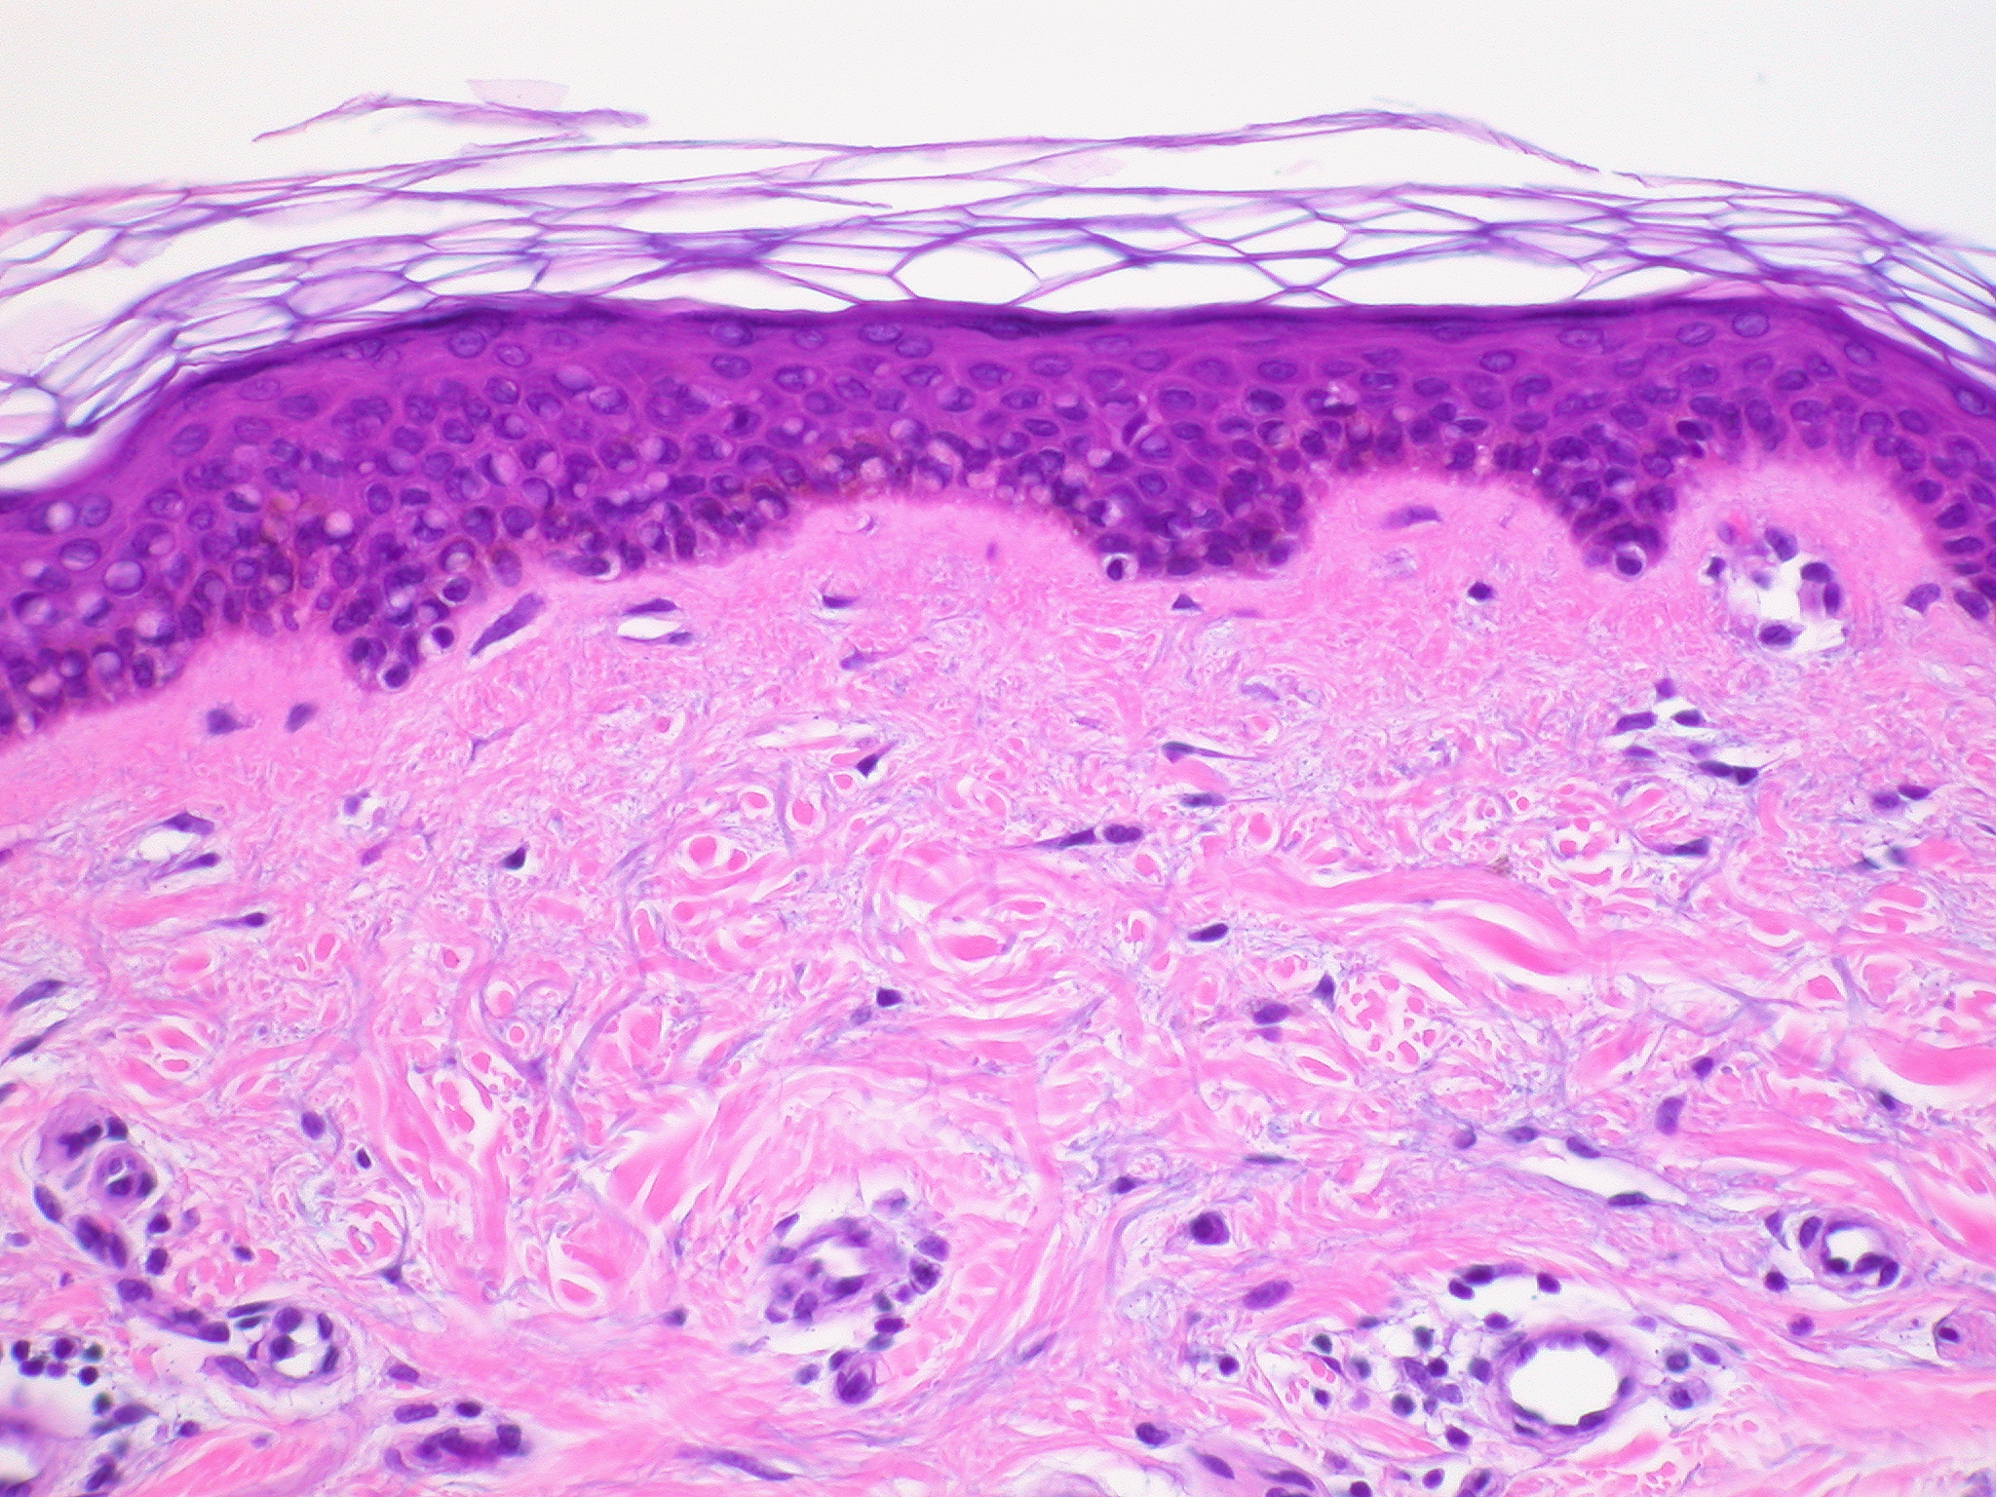

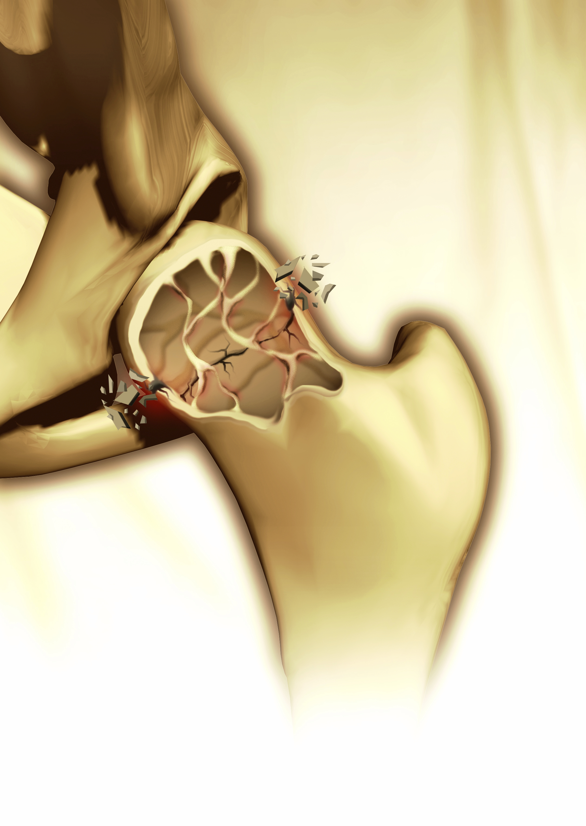
Current biologicals Human tissues currently in Australian tissue banks:
Ocular tissue
Skin
Cardio-vascular tissue
Bone and tendons
Australian tissue banks are principally owned and operated on a not-for-profit basis by charitable organisations or state governments
13

Slide 14

The process for inclusion of biologicals in the ARTG
3. Evaluation Careful scrutiny of process of manufacture
Evaluation is undertaken by scientists and clinicians who look at data on:
quality
safety
efficacy
2. Preparation and lodgement of submission
4. Decision
Communication between the TGA and the sponsor
1. Preparation by the TGA of standards and guidelines
5. Finalisation
More information about what this means is provided later in the presentation
The Advisory Committee on Biologicals provides independent expert advice to the TGA about issues related to biologicals
14

Slide 15
Decisions are based on evidence Quality data is supplied by applicant
For example, when using banked ocular tissue from deceased donors, tests for viruses (such as HIV, HCV) must be validated through testing of the blood of the deceased donor.
Evaluated by biologists, virologists and others working for the TGA
Donor selection and testing
Control of manufacturing and transport
Microbial control
Stability
‘Critical materials’: quality of materials that come into contact with the product
Labelling to allow donor traceability
Donor traceability is an important consideration when evaluating quality data
15

Slide 16
Decisions are based on evidence Safety and efficacy data is supplied by the applicant
Nonclinical data
Evaluated by toxicologists
Clinical data
Usually evaluated by a medical doctor
Biological dynamics and kinetics – laboratory data regarding efficacy
Toxicology data – laboratory data regarding safety
Mostly results of clinical trials conducted by pharmaceutical companies or research organisations, using patients who have volunteered to participate
TGA
Tumorigenicity is an important consideration when evaluating safety data
16

Slide 17
Other requirements
Therapeutic Goods Orders are legally binding instruments that:
specify donor selection, to minimise the chance of infectious disease transmission
require traceability of each product to the donor
require bioburden (microbial growth) testing
describe acceptable storage and transport conditions
Like medicines, biologicals are required to be manufactured according to Good Manufacturing Practice (GMP). All manufacturers are inspected to ensure GMP-compliance.
17

Slide 18
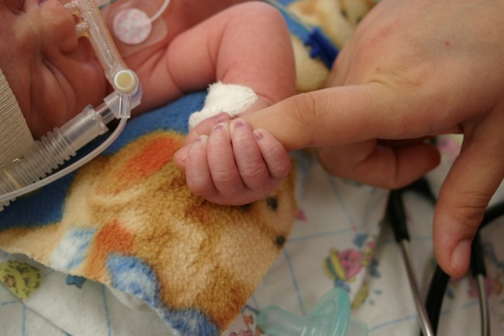
Exceptional release provisions
The TGA can apply exceptional release provisions to treat life-threatening conditions
For example, a paediatric heart valve becomes available at a valve bank for a critically ill baby but it is not possible to wait 10 days for tissue microbial testing results
This paediatric heart valve does not meet the required safety standards or current manufacturing standards but the TGA releases the product due to the exceptional circumstances

Slide 19

Postmarket monitoring Reporting adverse events
Adverse event reporting relates to unintended harmful effects or new information that contradicts existing knowledge about the quality, safety or efficacy of a biological
For biologicals, the reporting process is based on existing processes established within the TGA
Sponsors are required to monitor, record and report all adverse events to the TGA
Medical practitioners, patients, and others are also encouraged to report
The TGA will investigate and respond to adverse events as appropriate
In addition to the mandatory reporting requirements there is also a voluntary incident reporting scheme where any incidents involving a biological can be reported.
There are also five other modules in this suite of educational material, including one specific to postmarket monitoring. These can be accessed by the links on the next slide.
19

Slide 20
Other education modules include:
Introduction to the TGA
Medicines
Medical devices
Postmarket monitoring
Good Manufacturing Practiceaa

